Slide 1
CSE514 – Datamining Fall 2022 Association Rules Mining
Cynthia Ma
Department of Computer Science
Washington University in St. Louis
czma@wustl.edu
Notes:
11.9일,병찬
오늘도 처음부터 카훗..
What practical applications are there for mining Frequent itemsets?
Shopping recommendation
어쏘시에이션 룰 해석하는 문제. 슬라이드랑 똑같이 나옴.
How many itemsets of size>0 can you make from this dataset?(여기 ppt 슬라이드 6쪽)
7개

Slide 2
Frequent pattern mining
Searching for recurring relationships in a data set
Frequent itemset
A set of items that often appear together in a data set
Frequent sequential pattern
A series of items that often occur in sequence
Frequent structured pattern
A structural form like a graph or tree that often appears in ordered data

Slide 3
Market Basket Analysis
Analyze customer buying habits by finding associations between the different items that customers place in their “shopping basket”
Items frequently purchased together can be placed together to encourage combined sales
Items frequently purchased together can be place far apart to encourage more customer browsing
A sale on one item can encourage purchases of other items that are frequently purchased together

Slide 4
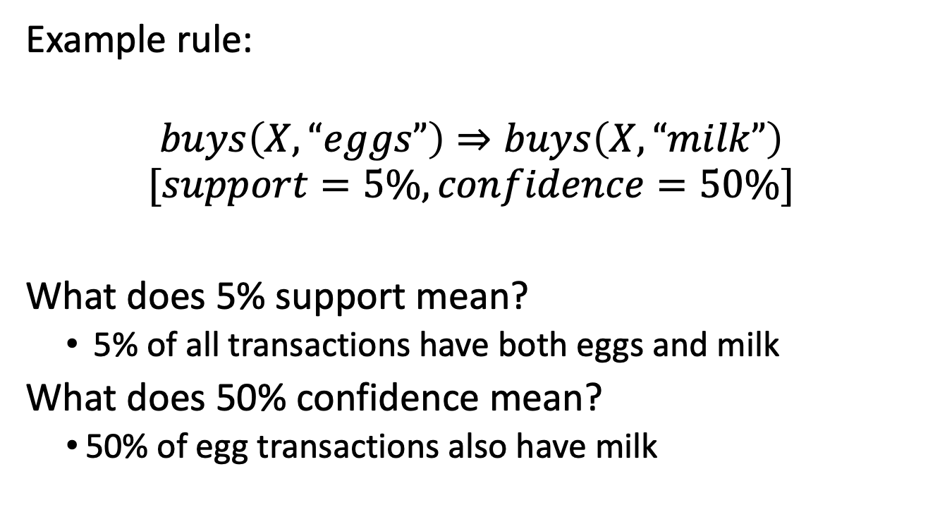
Association Rules Mining
Predicate/attribute
Example rule:
$$buys\left(X, “eggs”\right)⇒buys\left(X, “milk”\right)$$
$$[support=5\%, confidence=50\%]$$
What does 5% support mean?
5% of all transactions have both eggs and milk
What does 50% confidence mean?
50% of egg transactions also have milk
Notes:
병찬,
여기에서 카훗 문제 나옴

Slide 5
Rule Structure
Assuming we’re working with single-dimensional association rules
For itemset = {Bread, Eggs, Milk}
there exists an association rule:
{Bread, Egg} ➪ {Milk}
Antecedent
The implication is co-occurrence, not causality
Consequent
Notes:
병찬,
Antecedent, 선행사건
Consequent, 결과
원인 결과를 설명하는게 아니다.
그냥 같이 일어났다는거다.

Slide 6
Example
Bread
60
Eggs
75
Milk
5
40
1
100 transactions total
Itemsets:
{Bread} {Eggs} {Milk}
{Bread, Eggs} {Bread, Milk} {Eggs, Milk}
{Bread, Eggs, Milk}
Notes:
병찬,
How many itemsets of size>0 can you make from this dataset?

Slide 7
Generating itemsets
The first step to Association Rule Mining is the creation of itemsets from a list of items
This can get very costly!
Ex. List of 10 items has 1000+ possible itemsets
List of 20 items has 1mil+ possible itemsets
How can we avoid having to generate and store so many itemsets?
Filter for frequency by using Support
Notes:
병찬,
이거 itemset 만드는거가 경우의 수가 너무 많이 나온다.
그럼 어떻게 해야 하나? => 다음 슬라이드

Slide 8
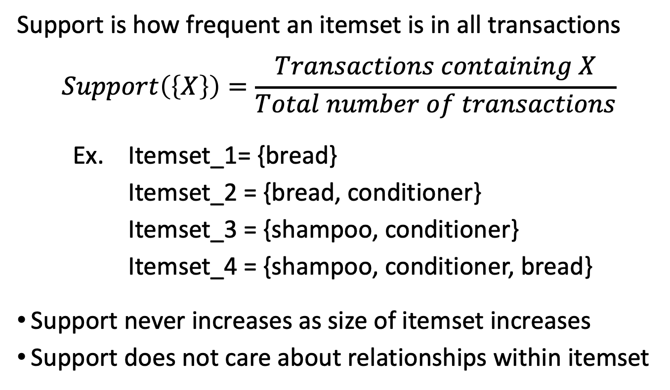
Support
Support is how frequent an itemset is in all transactions
$$Support\left(\left\{X\right\}\right)=\frac{Transactions containing X}{Total number of transactions}$$
Ex. Itemset_1= {bread}
Itemset_2 = {bread, conditioner}
Itemset_3 = {shampoo, conditioner}
Itemset_4 = {shampoo, conditioner, bread}
Support never increases as size of itemset increases
Support does not care about relationships within itemset

Slide 9
Minimum Support
Itemsets can be filtered using a minimum support threshold
Itemsets that pass the min_Support threshold are considered frequent
This helps with filtering what to store, but what about generating?
Apriori principle:
If an itemset is infrequent,
then all its supersets must also be infrequent
Notes:
병찬,
결국 모든 itemset 을 만드는게 너무 많으니까
최소 지지도(support) 를 두어서 그거 밑으로는 필터링 한다.

Slide 10
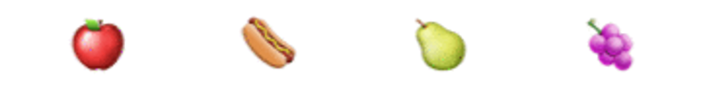

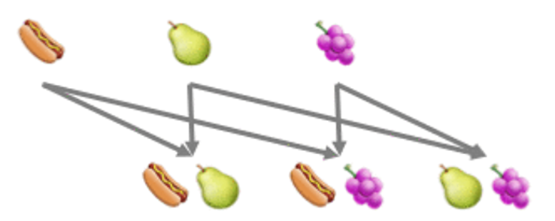
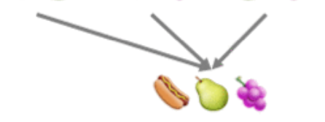
Apriori Algorithm
Start with itemsets containing single items
Calculate itemsets’ support. Remove itemsets below minimum support
Generate all possible itemsets from merging current itemsets
Repeat steps 2 + 3 until no more itemsets to be made
Notes:
병찬,
We only needed to create 8 itemsets from 4 items. What fraction of the full list of itemsets is this?
정답 – 50%(다음 슬라이드 참조)

Slide 11
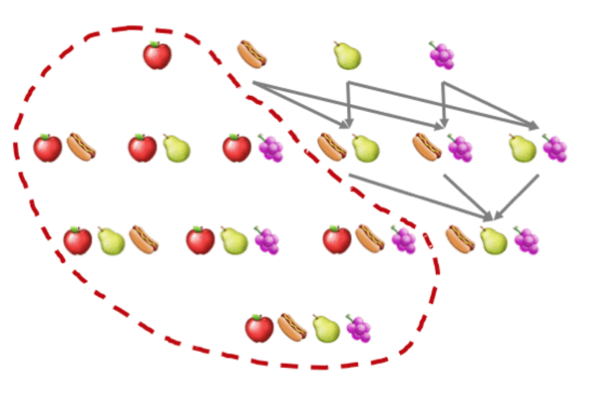
https://www.kdnuggets.com/2016/04/association-rules-apriori-algorithm-tutorial.html/2

Slide 12
Example
Bread
60
Eggs
75
Milk
5
40
1
100 transactions total
Itemsets with Support >= 10%:
{Bread} {Eggs} {Milk}
{Bread, Eggs}
Notes:
병찬,
밀크는 10퍼센트가 안되니까 제거한다.

Slide 13
Example
Bread
60
Eggs
75
Milk
5
40
1
100 transactions total
Itemsets with Support >= 1%:
{Bread} {Eggs} {Milk}
{Bread, Eggs} {Bread, Milk} {Eggs, Milk}
Notes:
병찬,
Egg 랑 milk 가 아예 transaction 이 없으므로 제거되고
그로인해 전체 set 도 생성 안한다.

Slide 14
Example
Bread
60
Eggs
75
Milk
5
40
1
100 transactions total
Rules using all itemsets:
{Bread} -> {Eggs} {Bread} -> {Milk} {Eggs} -> {Milk}
{Eggs} -> {Bread} {Milk} -> {Bread} {Milk} -> {Eggs}
{Bread} -> {Eggs, Milk} {Eggs, Milk} -> {Bread}
{Eggs} -> {Bread, Milk} {Bread, Milk} -> {Eggs}
{Milk} -> {Bread, Eggs} {Bread, Eggs} -> {Milk}
Notes:
병찬,
결국 rule 몇 개 만들수 있는지 카훗에서 문제 냈음.

Slide 15
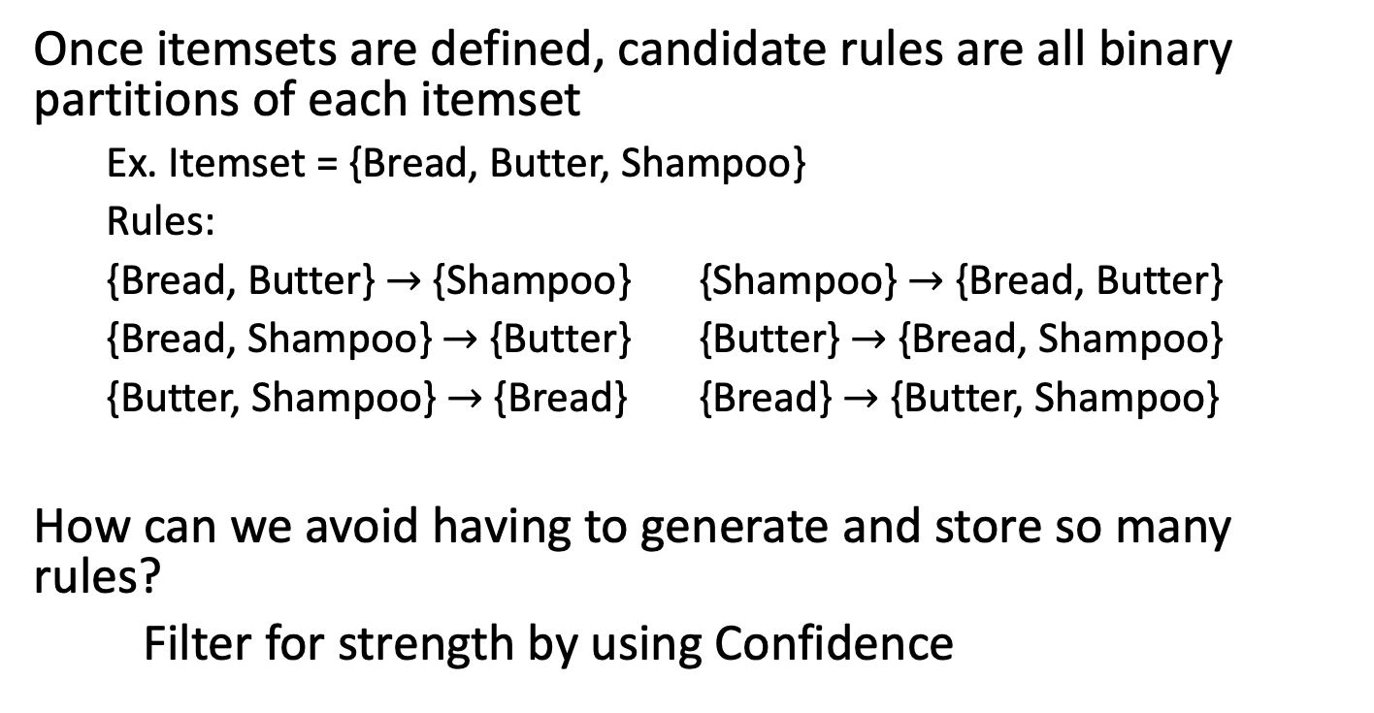
Generating Association Rules
Once itemsets are defined, candidate rules are all binary partitions of each itemset
Ex. Itemset = {Bread, Butter, Shampoo}
Rules:
{Bread, Butter} $→$ {Shampoo} {Shampoo} $→$ {Bread, Butter}
{Bread, Shampoo} $→$ {Butter} {Butter} $→$ {Bread, Shampoo}
{Butter, Shampoo} $→$ {Bread} {Bread} $→$ {Butter, Shampoo}
How can we avoid having to generate and store so many rules?
Filter for strength by using Confidence
Notes:
병찬,
Itemset 을 찾아낸 다음에 Rule 을 정의해야 되는거네!

Slide 16
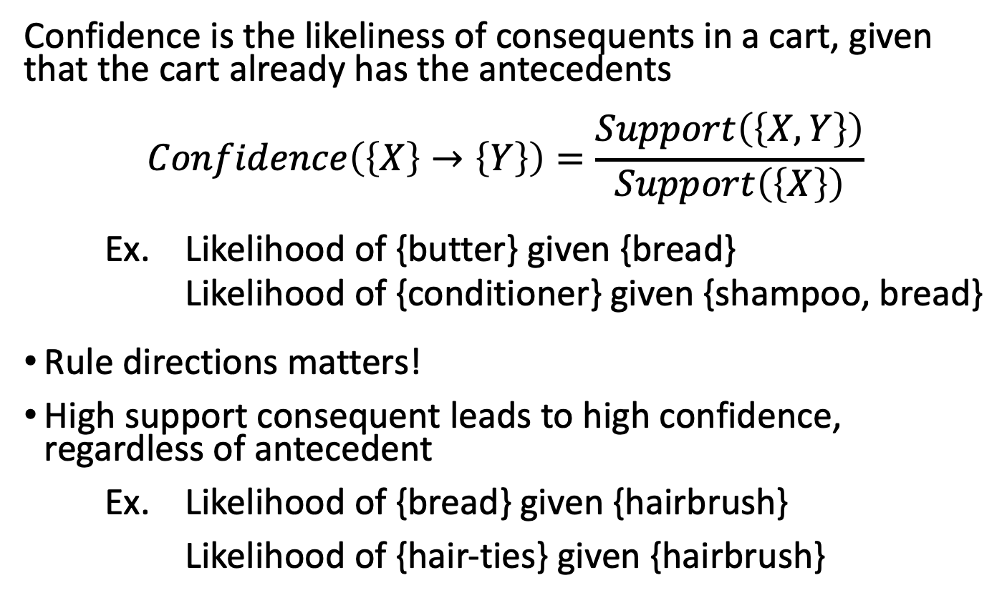
Confidence
Confidence is the likeliness of consequents in a cart, given that the cart already has the antecedents
$$Confidence\left(\left\{X\right\}→\left\{Y\right\}\right)=\frac{Support\left(\left\{X,Y\right\}\right)}{Support\left(\left\{X\right\}\right)}$$
Ex. Likelihood of {butter} given {bread}
Likelihood of {conditioner} given {shampoo, bread}
Rule directions matters!
High support consequent leads to high confidence, regardless of antecedent
Ex. Likelihood of {bread} given {hairbrush}
Likelihood of {hair-ties} given {hairbrush}
Notes:
병찬,
컨피던스 계산방법이 나오는구만.
여기서는 rule 방향이 중요하다.
카훗. Likelihood of {hair-ties} given {hairbrush} is the confidenc of which rule?
정답 {hairbrush} -> {hair-ties}

Slide 17
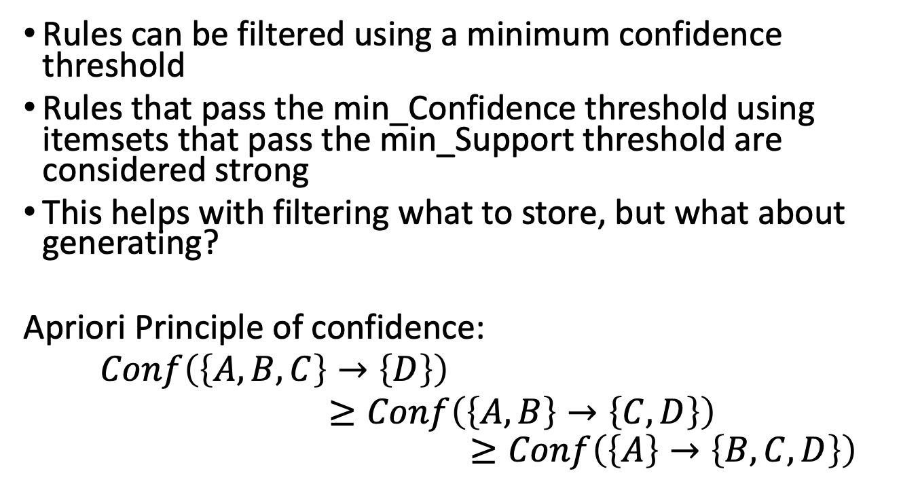
Minimum Confidence
Rules can be filtered using a minimum confidence threshold
Rules that pass the min_Confidence threshold using itemsets that pass the min_Support threshold are considered strong
This helps with filtering what to store, but what about generating?
Apriori Principle of confidence:
$Conf\left(\left\{A,B,C\right\}→\left\{D\right\}\right)$
$≥Conf\left(\left\{A,B\right\}→\left\{C,D\right\}\right)$
$$≥Conf\left(\left\{A\right\}→\left\{B, C,D\right\}\right)$$
Notes:
카훗
What practical use does this principle have? ‘Apriori Principle of confidence’
=> 정답

Slide 18
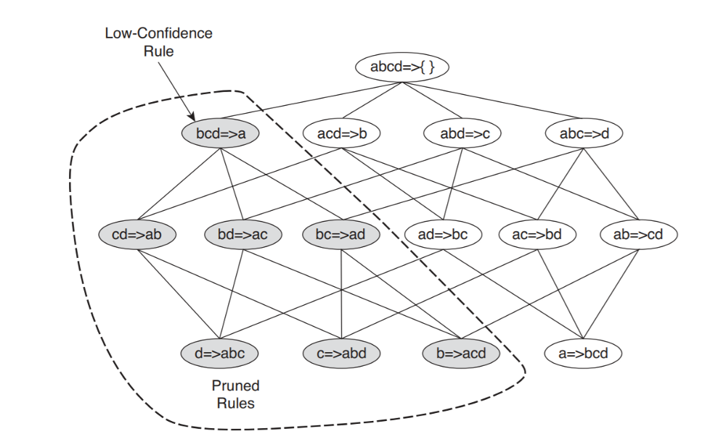
https://www-users.cs.umn.edu/~kumar001/dmbook/ch6.pdf
Notes:
병찬,
결국 점섬친거는 다 없애도 된다는거, 점선친거 헤드의 결과가 시원찮으면 그 밑으로 가면 confidence 가 더더 낮아져서 볼필요가 없음.

Slide 19
Example
Bread
60
Eggs
75
Milk
5
40
1
100 transactions total
Rules with Confidence >= 50%:
{Bread, Eggs, Milk} -> {}
{Bread, Eggs} -> {} {Bread, Milk} -> {} {Eggs, Milk} -> {}
{Bread} -> {Eggs} {Eggs} -> {Bread}
{Bread} -> {Milk} {Milk} -> {Bread}
Notes:
카훗. Using no minimum support, and Confidence >= 50%, how many strong rules are there?
결국 2개만 남았는데 {} 로 가는거는 공백이라서 포함시키지 않는다.
이게 알고리즘이 null 을 placeholder 로 썼기 때문에 그런거임.

Slide 20
Strong doesn’t mean Interesting
{Eggs} -> {Bread}
[Support = 40%, Confidence = 53.3%]
Bread
60
Eggs
75
Milk
5
40
1
Notes:
병찬, 40/75 = 53.3%
카훗. Eggs buying is associated with an increase in bread buying.
=> False 이다. 왜냐? 다음 슬라이드에 나옴

Slide 21
Strong doesn’t mean Interesting
Buying bread leads to eggs 53% of the time
Eggs are bought 75% of the time
Bread and eggs are actually negatively associated!
Bread
60
Eggs
75
Milk
5
40
1

Slide 22
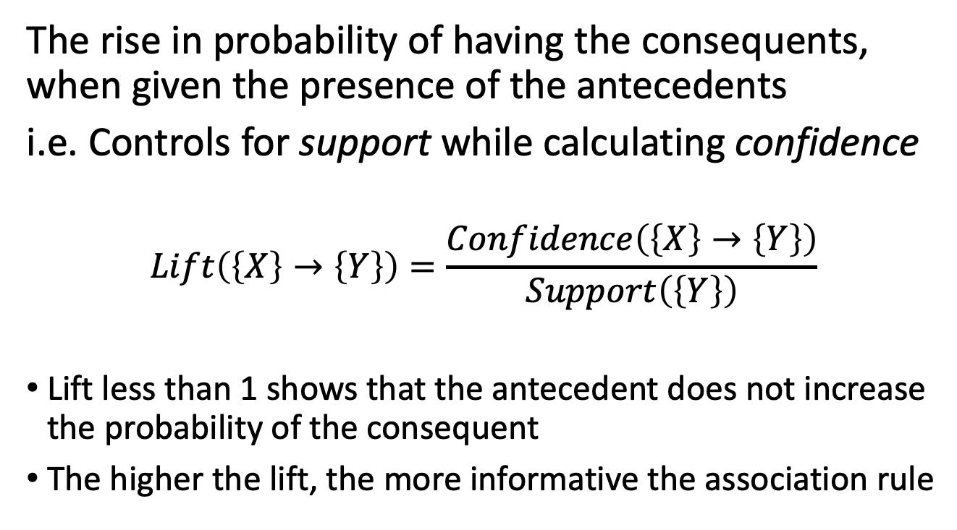
Lift
The rise in probability of having the consequents, when given the presence of the antecedents
i.e. Controls for support while calculating confidence
$$Lift\left(\left\{X\right\}→\left\{Y\right\}\right)=\frac{Confidence\left(\left\{X\right\}→\left\{Y\right\}\right)}{Support\left(\left\{Y\right\}\right)}$$
Lift less than 1 shows that the antecedent does not increase the probability of the consequent
The higher the lift, the more informative the association rule

Slide 23
Example
Bread
60
Eggs
75
Milk
5
40
1
100 transactions total
Rules with Confidence >= 50%:
{Bread} -> {Eggs} {Eggs} -> {Bread}
Neither have Lift > 1, so neither are “interesting”
Notes:
병찬,

Slide 24
Useful terms
Frequent: an itemset that passes support threshold
Strong: a rule on a frequent itemset that passes confidence threshold
Closed: an itemset for which there is no super-itemset with the same support
Closed Frequent Itemset: a frequent itemset for which there is no super-itemset with the same support
Maximal Frequent Itemset: a frequent itemset for which there is no super-itemset that is frequent

Slide 25
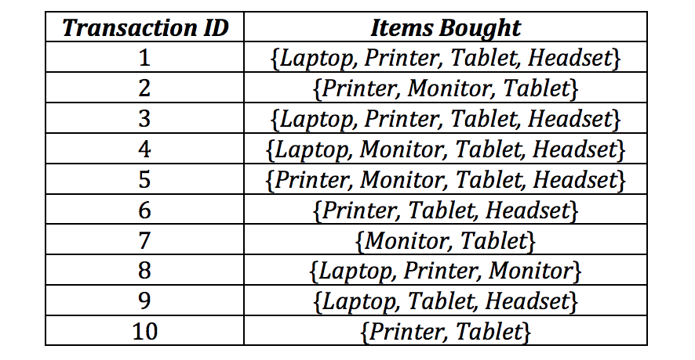
Example

Slide 26
Homework
Exam 1 regrade requests are open until midnight next Tuesday, Nov 15
HW 6 is released
Programming Assignment 2 is due Nov 30

